Slide 1
Naive Bayes algorithm is a supervised learning algorithm, which is based on Bayes theorem and used for solving classification problems.
It is mainly used in text classification that includes a high-dimensional training dataset.
Naive Bayes Classifier is one of the simple and most effective Classification algorithms which helps in building the fast machine learning models that can make quick predictions.
It is a probabilistic classifier, which means it predicts on the basis of the probability of an object.
Some popular examples of Naive Bayes Algorithm are spam filtration, Sentimental analysis, and classifying articles.

Slide 2
Why is it called Naive Bayes?
The Naive Bayes algorithm is comprised of two words Naive and Bayes, Which can be described as:
Naive: It is called Naive because it assumes that the occurrence of a certain feature is independent of the occurrence of other features. Such as if the fruit is identified on the bases of color, shape, and taste, then red, spherical, and sweet fruit is recognized as an apple. Hence each feature individually contributes to identify that it is an apple without depending on each other.
Bayes: It is called Bayes because it depends on the principle of Bayes' Theorem.

Slide 3
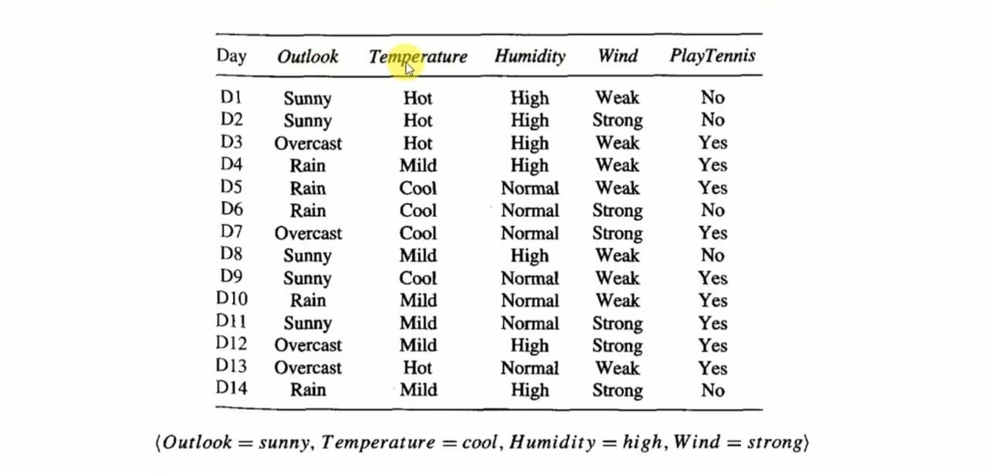
Example1

Slide 4
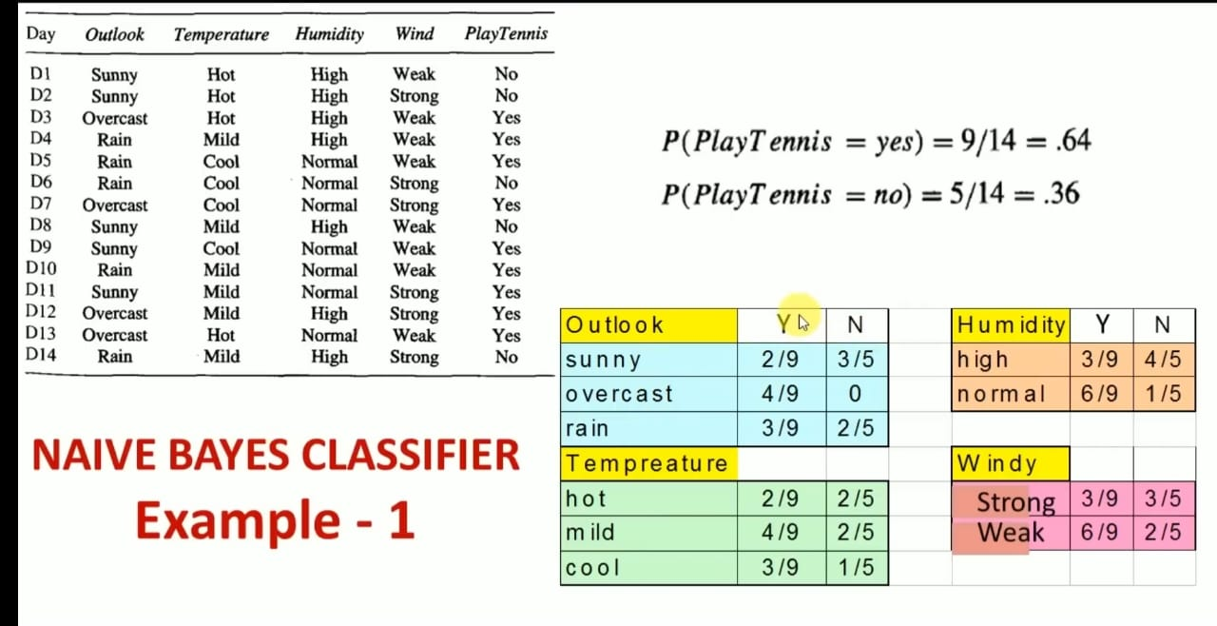
Prior probability
Likelihood probability

Slide 5
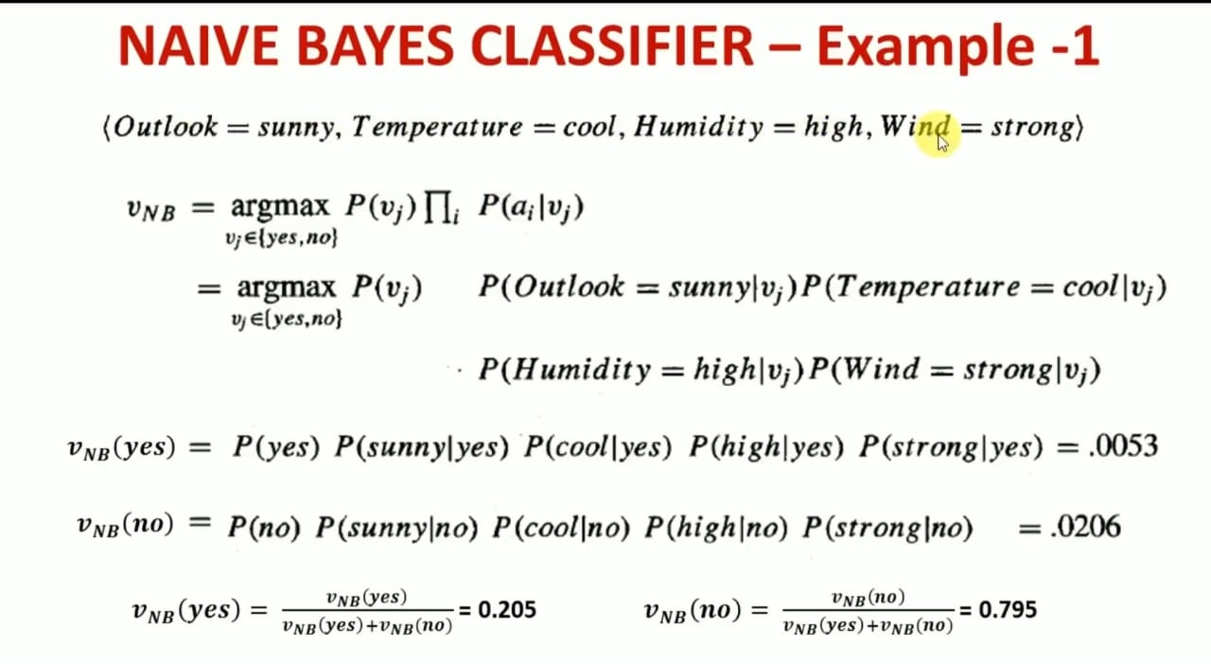
ai= set of attributes, vj= possible outcome

Slide 6
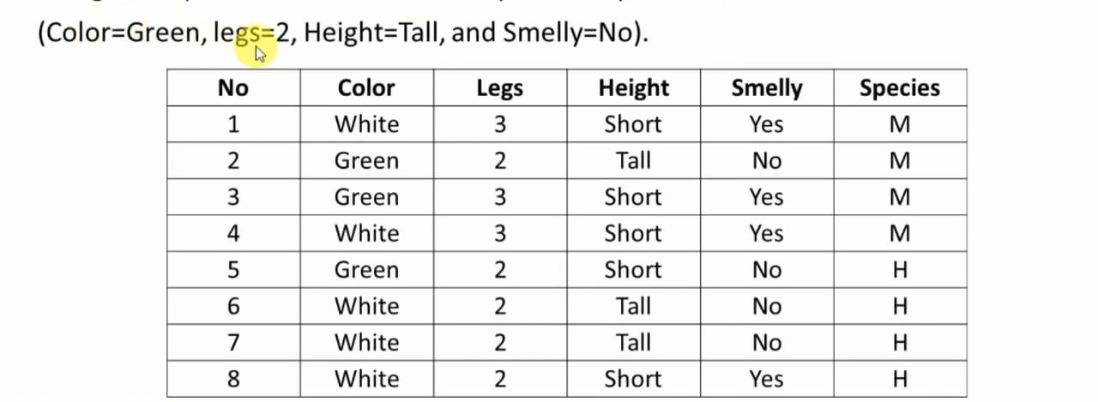
Example-2

